Slide 1
PROJECT TITLE
TS- WEB/CC/AI TRACK CAPSTONE PROJECT
Presented By:
1. Miss S.Narkees Banu -BCA
2. Miss M.Thansheela Banu- BCA
3.Miss A.Aasha Parveen-Bsc ComputerSciencec
4.Miss N.AkkilaThagshin-Bsc Computer Science
Guided By:

Slide 2
OUTLINE
Abstract
Problem Statement (Should not include solution)
Aims , Objective & Proposed System/Solution
System Design
System Development Approach(Technology Used)
Algorithm & Deployment
Conclusion
References
Future Scope

Slide 3
Abstract
The aim of this project is to develop a system which can perform early prediction of diabetes for a patient with a higher accuracy by combining the results of different machine learning techniques. The algorithms like K nearest neighbour, Logistic Regression, Random forest, Support vector machine and Decision tree are used. The accuracy of the model using each of the algorithms is calculated. Then the one with a good accuracy is taken as the model for predicting the diabetes.

Slide 4
Problem Statement
Machine learning techniques helps the doctors
to predict early stage for diabetics. Diabetics patient medical record and different types of algorithms are added in dataset for
experimental analysis. we use logistic regression, random forest, decision tree classifier and gradient boosting to predict whether a
patient has diabetes based on diagnostic measurements. Performance and accuracy of the applied algorithms is discussed and
compared

Slide 5
Proposed Solution
AI is being used to check for the early detection of diabetes-related conditions such as diabetic retinopathy which is a condition that leads to a loss of vision. The AI software can determine if the patient needs to be referred to an ophthalmologist right away.

Slide 6
System Architecture
The system architecture for the Diabetes Management System presented below in Figure 1 is the conceptual model that defines the structure, behavioural interactions, and multiple system views that underpins the system development. It presents the formal descriptions of the systems captured graphically that supports reasoning, and the submodules developed as well as the dataflows between the developed modules.

Slide 7
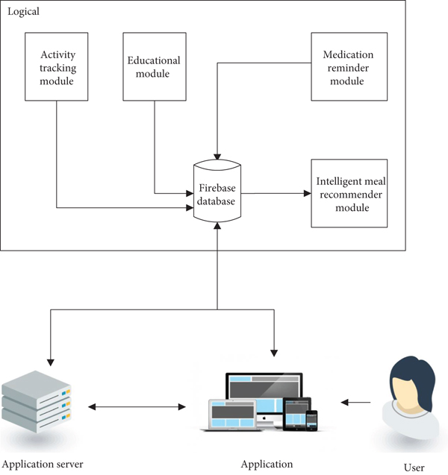

Slide 8
Algorithm & Deployment
For gesture recognition, the K-Nearest Neighbor (KNN) algorithm is a supervised machine-learning algorithm. KNN is used for classification, by which a data point's classification is determined by how its neighbor is classified

Slide 9
Conclusion
As a consequence, the integration of education and management approaches with mobile health and AI technologies has become an unstoppable trend
We will proceed with discussing and comparing the strengths and drawbacks of some well-known AI-based methods when certain standards and benchmark data sets are prepared in our future work.

Slide 10
Reference
[1] Cuda dnn – cudnn. https://developer.nvidia.com/cudnn.
[2] Cyber science. https://apps.leapmotion.com/apps/cyber-science-motion/windows.
3] Galaxy zoo – the galaxy challenge. https://www.kaggle.com/c/ galaxy-zoo-the-galaxy-challenge. [4] Large scale visual recognition challenge 2010. http://image-net.org/challenges/LSVRC/2010/.
[5] Large scale visual recognition challenge 2015. http://image-net.org/challenges/LSVRC/2015/index.

Slide 11
Future Scope
The scope of Artificial Intelligence is limited to domestic and commercial purposes as the medical and aviation sectors are also using AI to improve their services. If AI is outperforming human efforts, then opting for AI automation will reduce costs in the long run for a business.

Slide 12
THANK YOU

